Slide 1
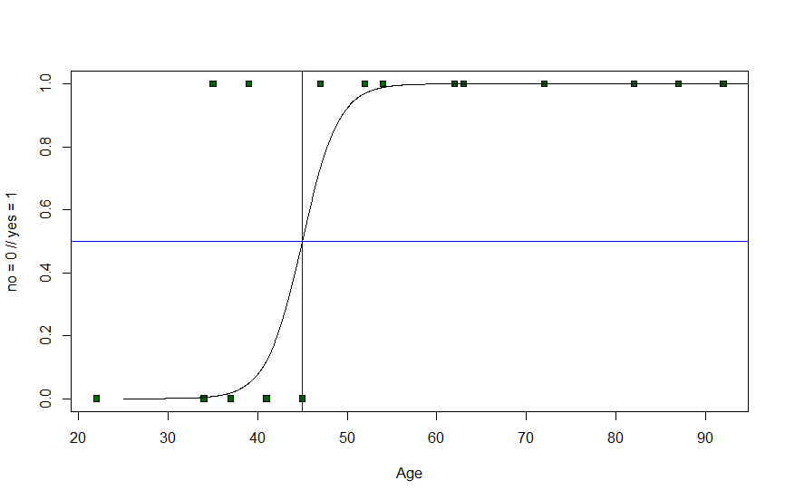
Dealing with missing data

Slide 2
Dealing with missing data
How to approach missing data?
4 Strategies to deal with missing data

Slide 3
Dealing with missing data
Name | Gender | Income
Scott | Male | $3000
Mike | Male | $4000
Frank | Male | $5000
James | Male | $7000
Maria | Female | $2000
Linda | Female | $3000
Sarah | Female | $6000
Jane | Female | $6000

Slide 4
Dealing with missing data
Name | Gender | Income
Scott | Male | $3000
Mike | Male | $4000
Frank | Male | $5000
James | Male | $7000
Maria | Female | $2000
Linda | Female | $3000
Sarah | Female | $6000
Jane | Female | $6000
Mean=$4750
Mean=$4250

Slide 5
Dealing with missing data
Name | Gender | Income
Scott | Male | NA
Mike | Male | $4000
Frank | Male | $5000
James | Male | NA
Maria | Female | $2000
Linda | Female | NA
Sarah | Female | NA
Jane | Female | $6000
Mean=$4500
Mean=$4000

Slide 6
Dealing with missing data
Name | Gender | Income
Scott | Male | $3000
Mike | Male | $4000
Frank | Male | NA
James | Male | NA
Maria | Female | $2000
Linda | Female | $3000
Sarah | Female | NA
Jane | Female | NA
Mean=$3500
Mean=$2500

Slide 7
Dealing with missing data
Name | Gender | Income | Degree
Scott | Male | $3000 | Non-academic
Mike | Male | $4000 | Non-academic
Frank | Male | NA | Academic
James | Male | NA | Academic
Maria | Female | $2000 | Non-academic
Linda | Female | $3000 | Non-academic
Sarah | Female | NA | Academic
Jane | Female | NA | Academic
Mean=$3500
Mean=$2500
Is the distribution of missing values really random?

Slide 8
Dealing with missing data
Name | Gender | Income | Degree
Scott | Male | $3000 | Non-academic
Mike | Male | $4000 | Non-academic
Frank | Male | NA | Academic
James | Male | NA | Academic
Maria | Female | $2000 | Non-academic
Linda | Female | $3000 | Non-academic
Sarah | Female | NA | Academic
Jane | Female | NA | Academic
Mean=$3500
Mean=$2500
Is the distribution of missing values really random?
Systematic bias!

Slide 9
Strategies dealing with missing data
Name | Gender | Income | Degree
Scott | Male | $3000 | Non-academic
NA | Male | $4000 | Non-academic
Frank | Male | NA | Academic
NA | Male | $7000 | NA
Maria | Female | $2000 | Non-academic
Linda | NA | $3000 | Non-academic
Sarah | Female | NA | Academic
Jane | Female | NA | NA
Wendy | Female | $9000 | Non-academic
1. Delete the column with missing data

Slide 10
Strategies dealing with missing data
Name | Gender | Income | Degree
Scott | Male | $3000 | Non-academic
NA | Male | $4000 | Non-academic
Frank | Male | NA | Academic
NA | Male | $7000 | NA
Maria | Female | $2000 | Non-academic
Linda | NA | $3000 | Non-academic
Sarah | Female | NA | Academic
Jane | Female | NA | NA
Wendy | Female | $9000 | Non-academic
1. Delete the column with missing data
Pro:
Quick and easy
Con:
Potentially loosing information
Used:
If the column holds no relevant information

Slide 11
Strategies dealing with missing data
Name | Gender | Income | Degree
Scott | Male | $3000 | Non-academic
NA | Male | $4000 | Non-academic
Frank | Male | NA | Academic
NA | Male | $7000 | NA
Maria | Female | $2000 | Non-academic
Linda | NA | $3000 | Non-academic
Sarah | Female | NA | Academic
Jane | Female | NA | NA
Wendy | Female | $9000 | Non-academic
1. Delete the column with missing data
2. Delete all rows with missing data

Slide 12
Strategies dealing with missing data
2. Delete all rows with missing data
Name | Gender | Income | Degree
Scott | Male | $3000 | Non-academic
NA | Male | $4000 | Non-academic
Frank | Male | NA | Academic
NA | Male | $7000 | NA
Maria | Female | $2000 | Non-academic
Linda | NA | $3000 | Non-academic
Sarah | Female | NA | Academic
Jane | Female | NA | NA
Wendy | Female | $9000 | Non-academic
Pro:
Quick and easy
Con:
Potentially loosing a lot of rows
Used:
If there are not many missing values and all rows and all columns are important

Slide 13
Strategies dealing with missing data
Name | Gender | Income | Degree
Scott | Male | $3000 | Non-academic
NA | Male | $4000 | Non-academic
Frank | Male | NA | Academic
NA | Male | $7000 | NA
Maria | Female | $2000 | Non-academic
Linda | NA | $3000 | Non-academic
Sarah | Female | NA | Academic
Jane | Female | NA | NA
Wendy | Female | $9000 | Non-academic
1. Delete the column with missing data
2. Delete all rows with missing data
3. Delete all rows with missing
data in a specific column

Slide 14
Strategies dealing with missing data
Name | Gender | Income | Degree
Scott | Male | $3000 | Non-academic
NA | Male | $4000 | Non-academic
Frank | Male | NA | Academic
NA | Male | $7000 | NA
Maria | Female | $2000 | Non-academic
Linda | NA | $3000 | Non-academic
Sarah | Female | NA | Academic
Jane | Female | NA | NA
Wendy | Female | $9000 | Non-academic
1. Delete the column with missing data
2. Delete all rows with missing data
3. Delete all rows with missing
data in a specific column

Slide 15
Strategies dealing with missing data
Name | Gender | Income | Degree
Scott | Male | $3000 | Non-academic
NA | Male | $4000 | Non-academic
Frank | Male | NA | Academic
NA | Male | $7000 | NA
Maria | Female | $2000 | Non-academic
Linda | NA | $3000 | Non-academic
Sarah | Female | NA | Academic
Jane | Female | NA | NA
Wendy | Female | $9000 | Non-academic
3. Delete all rows with missing
data in a specific column
Pro:
More specific, leaves more missing values,
still not a lot of effort
Con:
Potentially loosing information, a little more effort
Used:
If this is an important column where we need data

Slide 16
Strategies dealing with missing data
Name | Gender | Income | Degree
Scott | Male | $3000 | Non-academic
Unknown | Male | $4000 | Non-academic
Frank | Male | NA | Academic
Unknown | Male | $7000 | NA
Maria | Female | $2000 | Non-academic
Linda | NA | $3000 | Non-academic
Sarah | Female | NA | Academic
Jane | Female | NA | NA
Wendy | Female | $9000 | Non-academic
1. Delete the column with missing data
2. Delete all rows with missing data
3. Delete all rows with missing
data in a specific column
4. Replace data with our best guess
(e.g. mean)

Slide 17
Strategies dealing with missing data
Name | Gender | Income | Degree
Scott | Male | $3000 | Non-academic
Unknown | Male | $4000 | Non-academic
Frank | Male | $4600 | Academic
Unknown | Male | $7000 | NA
Maria | Female | $2000 | Non-academic
Linda | NA | $3000 | Non-academic
Sarah | Female | $4600 | Academic
Jane | Female | $4600 | NA
Wendy | Female | $9000 | Non-academic
1. Delete the column with missing data
2. Delete all rows with missing data
3. Delete all rows with missing
data in a specific column
4. Replace data with our best guess
(e.g. mean) Imputation

Slide 18
Strategies dealing with missing data
4. Replace data with our best guess
(e.g. mean) Imputation
Name | Gender | Income | Degree
Scott | Male | $3000 | Non-academic
Unknown | Male | $4000 | Non-academic
Frank | Male | $4600 | Academic
Unknown | Male | $7000 | NA
Maria | Female | $2000 | Non-academic
Linda | NA | $3000 | Non-academic
Sarah | Female | $4600 | Academic
Jane | Female | $4600 | NA
Wendy | Female | $9000 | Non-academic
Pro:
Most amount of data
Con:
Potentially inaccurate information, more sophisticated
Used:
If you have enough data/features to predict and
we want to maintain as much data as possible

Slide 19
Strategies dealing with missing data
4. Replace data with our best guess
(e.g. mean) Imputation
Name | Gender | Income | Degree
Scott | Male | $3000 | Non-academic
Unknown | Male | $4000 | Non-academic
Frank | Male | $4600 | Academic
Unknown | Male | $7000 | NA
Maria | Female | $2000 | Non-academic
Linda | NA | $3000 | Non-academic
Sarah | Female | $4600 | Academic
Jane | Female | $4600 | NA
Wendy | Female | $9000 | Non-academic
Pro:
Most amount of data
Con:
Potentially inaccurate information, more sophisticated
Used:
If you have enough data/features to predict and
we want to maintain as much data as possible

Slide 20
Strategies dealing with missing data
Name | Gender | Income | Degree
Scott | Male | $3000 | Non-academic
Unknown | Male | $4000 | Non-academic
Frank | Male | $4600 | Academic
Unknown | Male | $7000 | NA
Maria | Female | $2000 | Non-academic
Linda | NA | $3000 | Non-academic
Sarah | Female | $4600 | Academic
Jane | Female | $4600 | NA
Wendy | Female | $9000 | Non-academic
1. Delete the column with missing data
2. Delete all rows with missing data
3. Delete all rows with missing
data in a specific column
4. Replace data with our best guess
(e.g. mean,regression) Imputation

